Slide 1
Capstone Project
Boroughs of Copenhagen and venues therein

Slide 2
Boroughs of Copenhagen
Introduction
The purpose of this project, was to visualize information regarding price per square meter for the boroughs of Copenhagen. This was to be combined with information on the venues within each borough.
Through the visualization both investors as well as potential private residents would be able to make a more informed decision prior to purchasing a property.

Slide 3
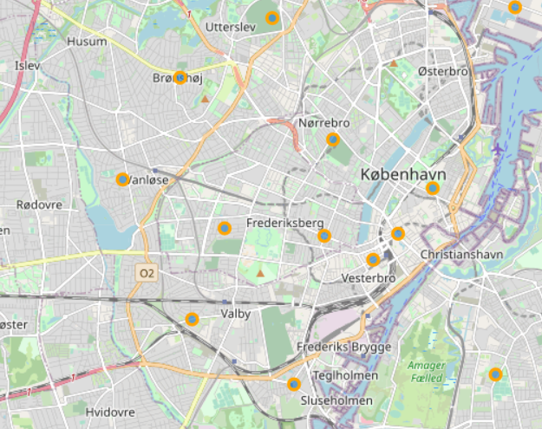
Boroughs of Copenhagen
Visualization of the boroughs of Copenhagen

Slide 4
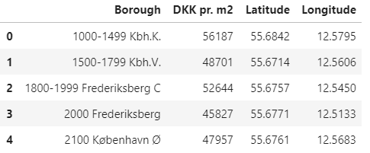
Price pr. sq. meter in Copenhagen
A table showing the price pr. square meter for every borough in Copenhagen was created.
For mapping purposes, latitude and longtiude information was also included in the table

Slide 5
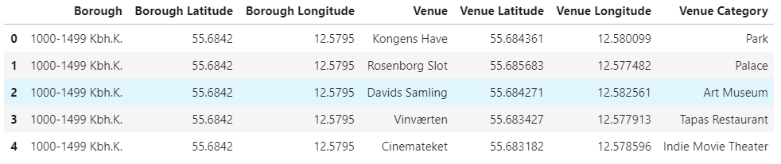
Venues of Copenhagen
Using the Foursquare API information about venues in Copenhagen was obtained.
A table was created based on the information obtained from Foursquare including information venue category, which borough it is located in as well as name of the venue.

Slide 6
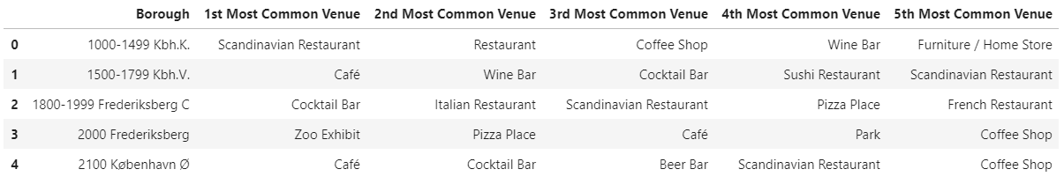
Venues of Copenhagen
Based on the information obtained from Foursquare, it was determined which venues were the most common venues in each borough.

Slide 7
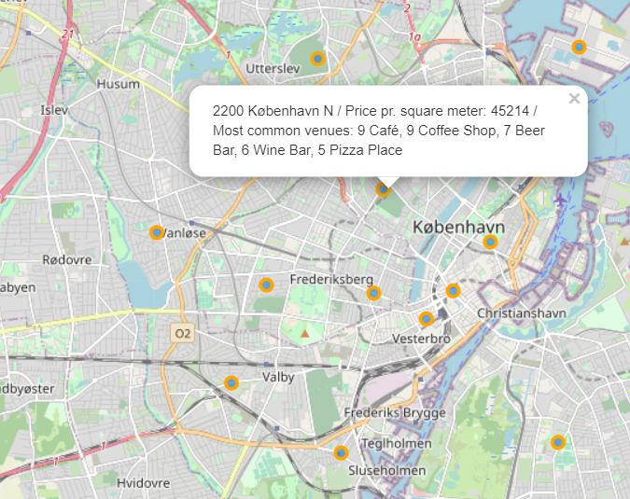
Boroughs of Copenhagen
The information was plotted on a map detailing the price pr. Square meter for every borough, as well as the 5 most common venues in the given borough.
The established tables and maps enables both an investor and a future private resident the ability to make a more informed decision about their purchase of property than otherwise.

